Slide 1
48-spot smFRET

Slide 2
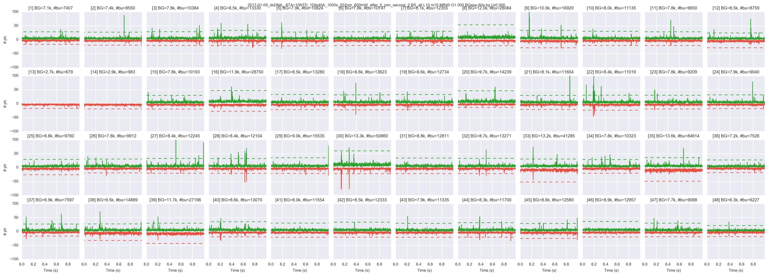
48-spot timetraces
dsDNA 18bp D-A distance

Slide 3
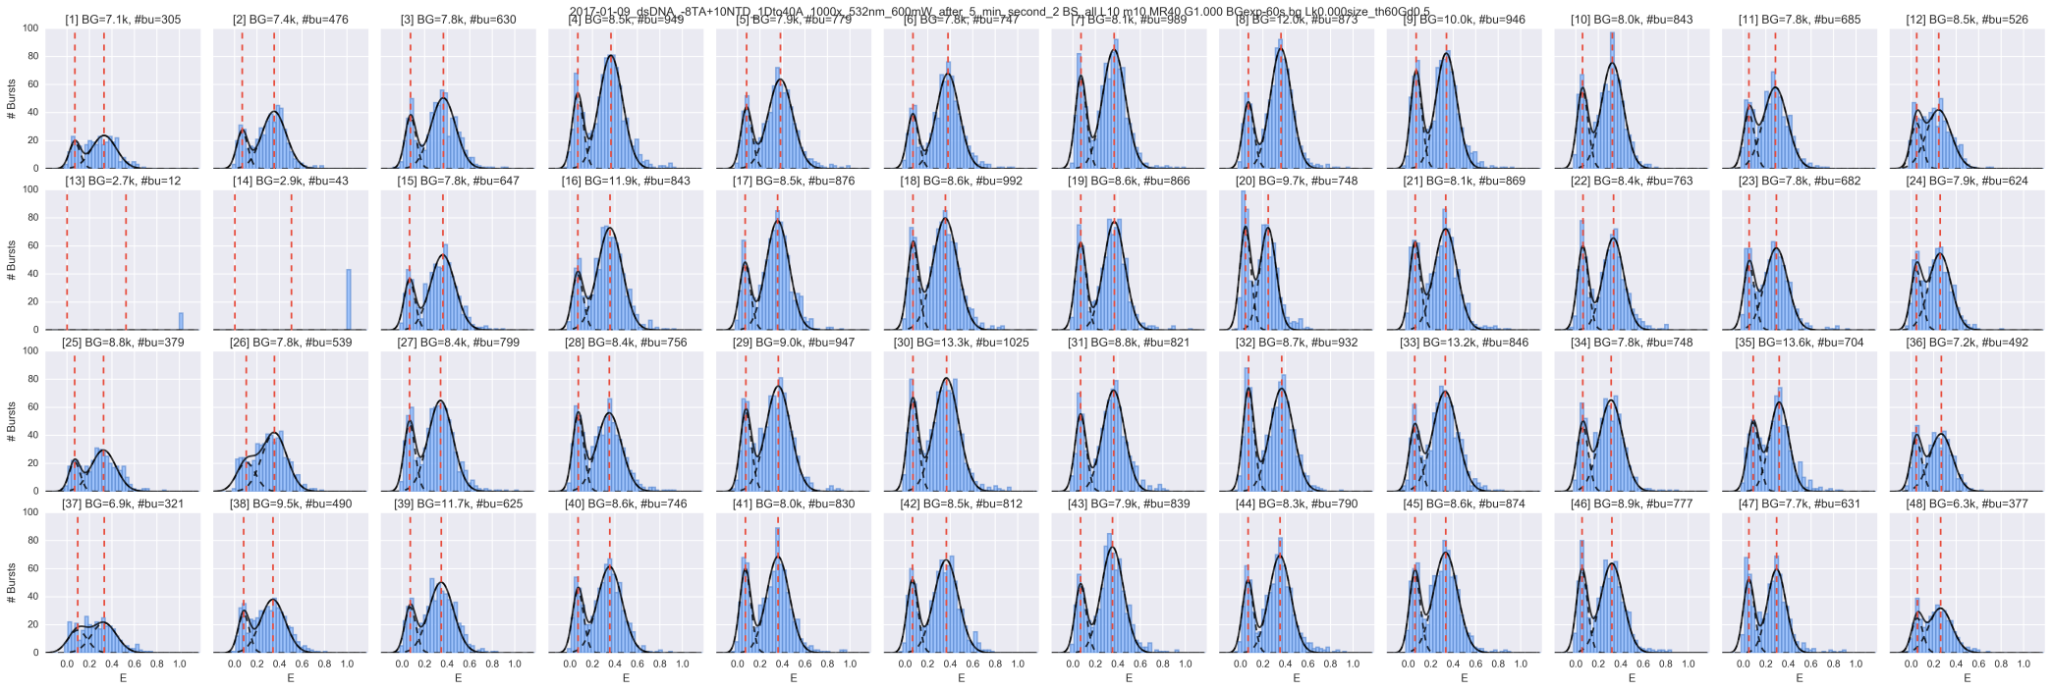
48-spot smFRET histograms
dsDNA 18bp D-A distance

Slide 4
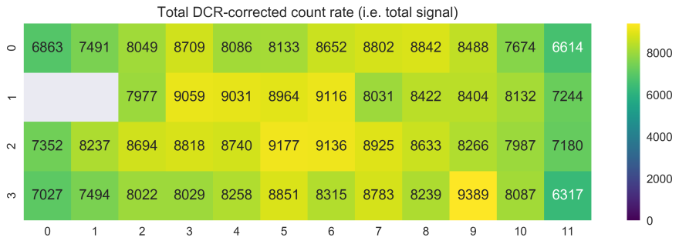
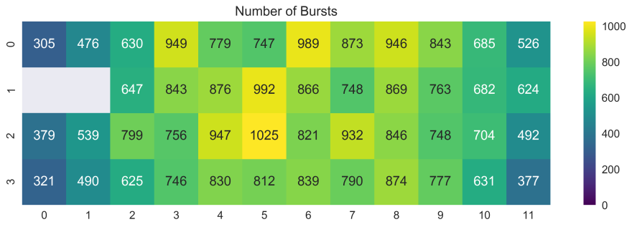
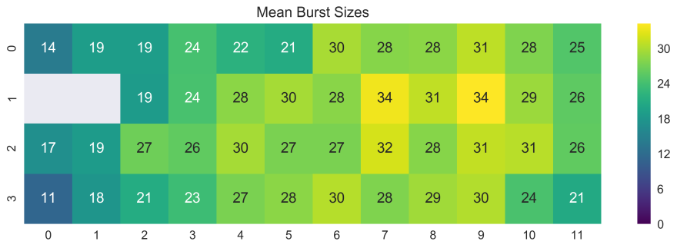
Spot Statistics
dsDNA 18bp D-A distance
Total DCR-corrected photon count-rate
Number of bursts
Mean burst sizes

Slide 5
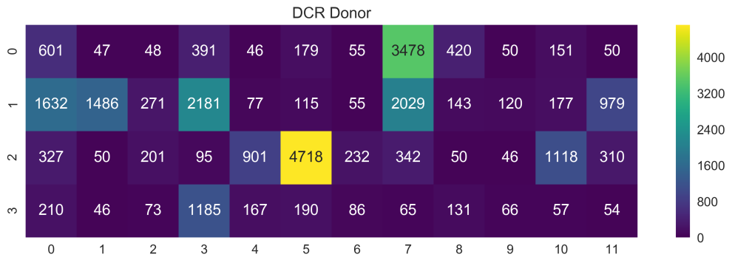
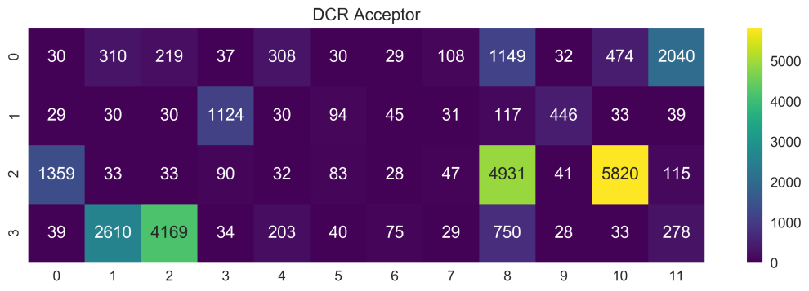
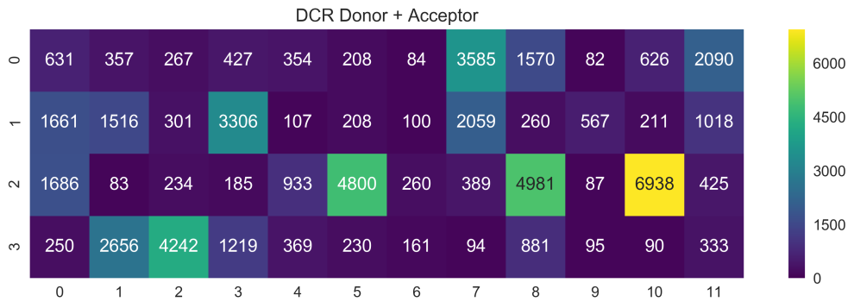
SPAD DCR
Donor
Acceptor
Donor + Acceptor

Slide 6

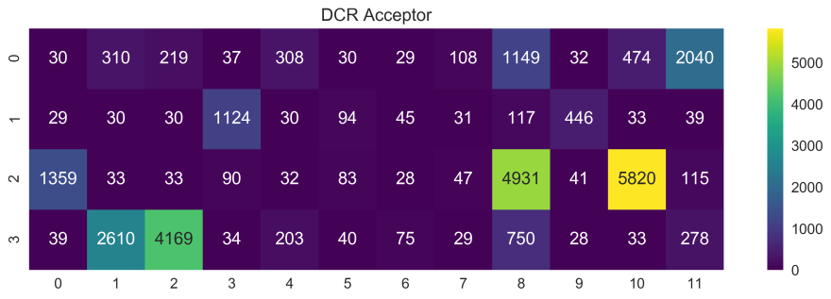

Spot Statistics
dsDNA 18bp D-A distance

Slide 7

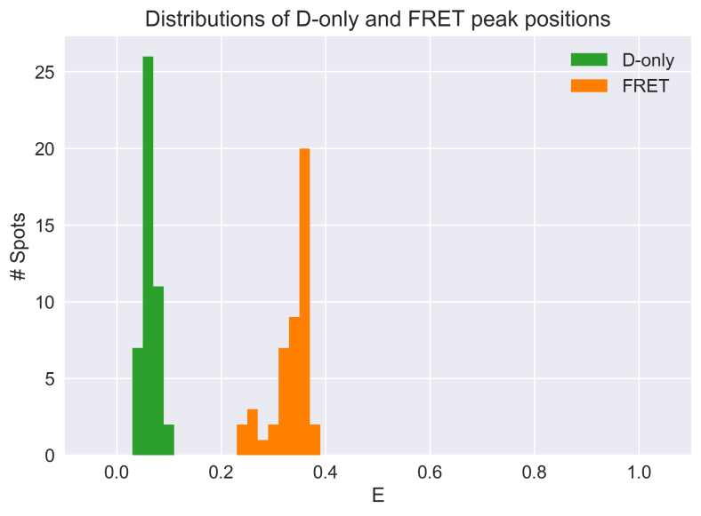
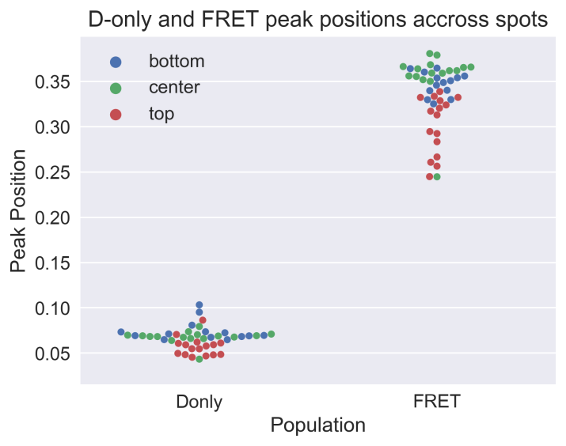
Spot Statistics
Spot map
top
dsDNA 18bp D-A distance
center
Fitted D-only and FRET peak’s centers across 48-spots
bottom
Histogram
Swarm-plot
E1 mean [min, max] = 0.066 [0.043, 0.103], σ = 0.012
E2 mean [min, max] = 0.335 [0.245, 0.381], σ = 0.036

Slide 8
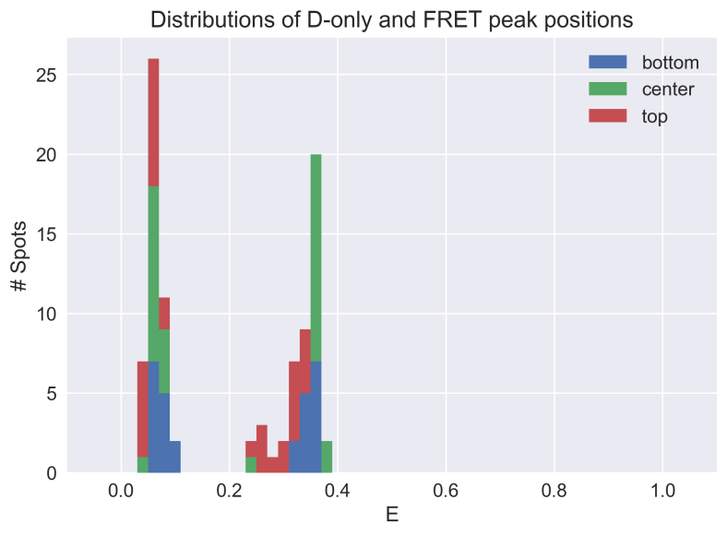
Spot Statistics
Spot map
top
dsDNA 18bp D-A distance
center
Fitted D-only and FRET peak’s centers across 48-spots
bottom
Histogram
Swarm-plot
E1 mean [min, max] = 0.066 [0.043, 0.103], σ = 0.012
E2 mean [min, max] = 0.335 [0.245, 0.381], σ = 0.036

Slide 9

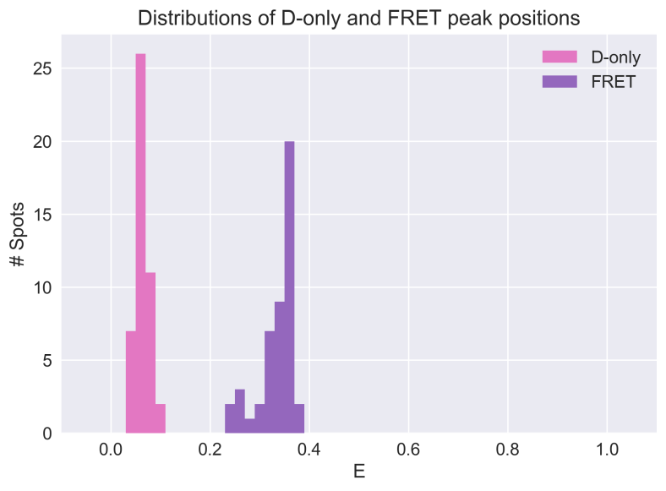
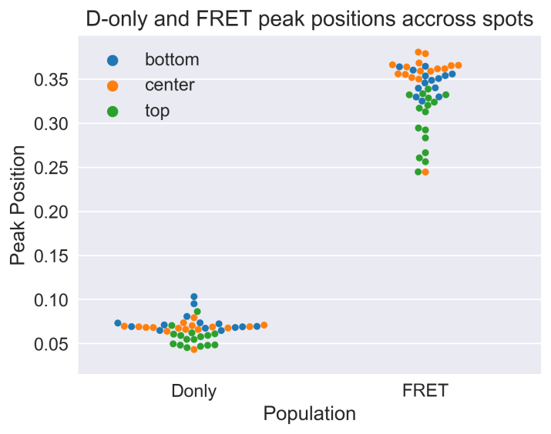
Spot Statistics
Spot map
top
dsDNA 18bp D-A distance
center
Fitted D-only and FRET peak’s centers across 48-spots
bottom
Histogram
Swarm-plot
E1 mean [min, max] = 0.066 [0.043, 0.103], σ = 0.012
E2 mean [min, max] = 0.335 [0.245, 0.381], σ = 0.036

Slide 10
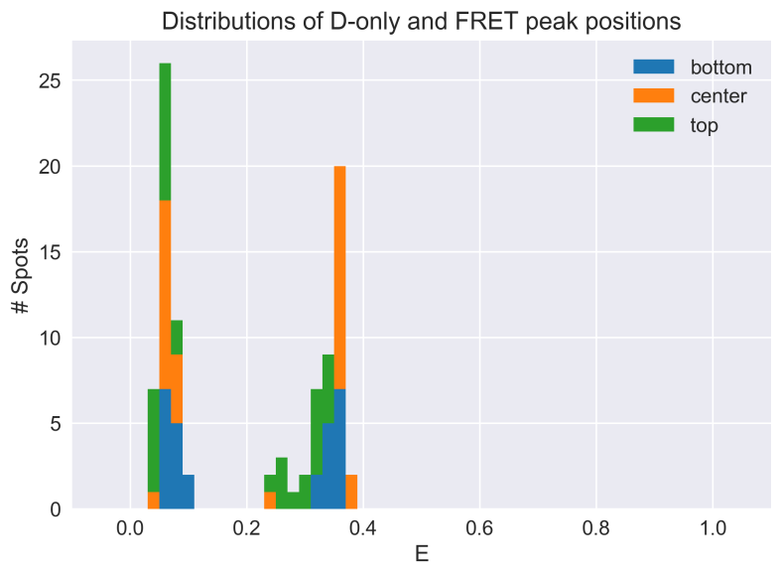
Spot Statistics
Pixel map
top
dsDNA 18bp D-A distance
center
Fitted D-only and FRET peak’s centers across 48-spots
bottom
Histogram
Swarm-plot
E1 mean [min, max] = 0.066 [0.043, 0.103], σ = 0.012
E2 mean [min, max] = 0.335 [0.245, 0.381], σ = 0.036

